Slide 1
DEEP Q-NETWORKS ON ATARI:
BASELINE DQN vs. DOUBLE DQN
By Patrick Cortez
CSCI 166 https://github.com/PaatriickC/CSCI-166-Project

Slide 2


PROJECT OVERVIEW
Goal: Implement DQN on one or two Atari environments
Compare baseline DQN vs. Double DQN
Evaluate training stability, reward trends, agent behavior
Deliverables: Code, videos, report, slides

Slide 3
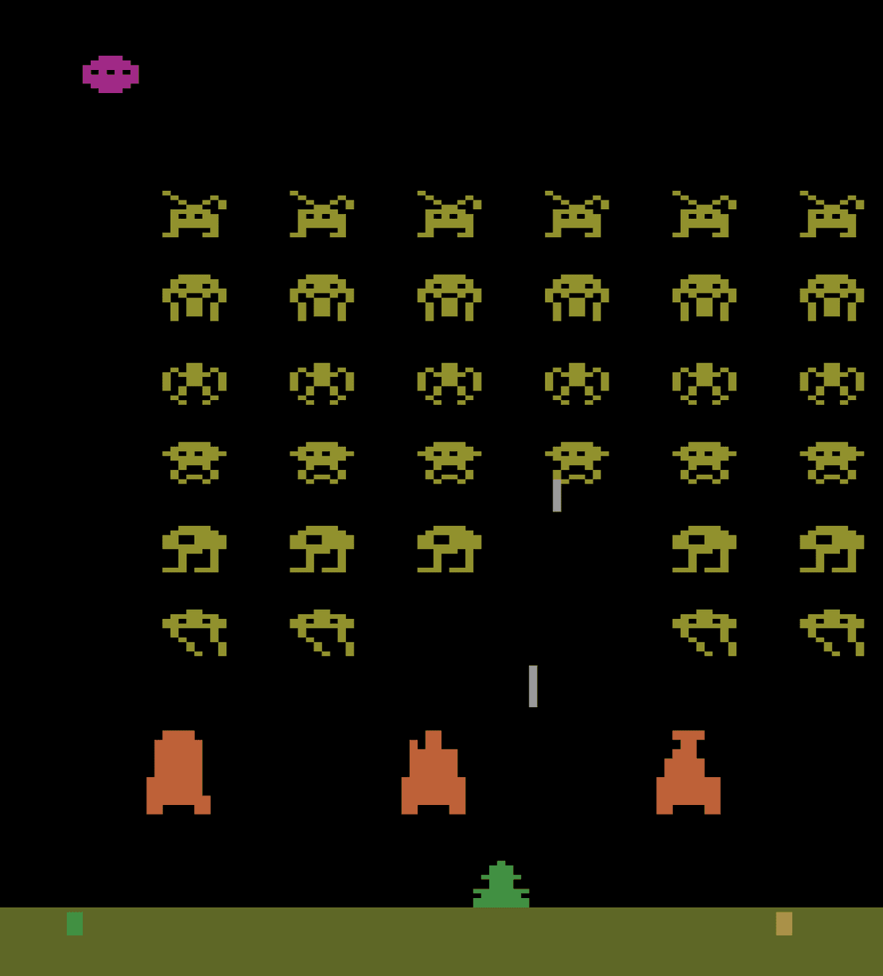

WHY ATARI? WHY THESE GAMES?
Classic reinforcement-learning benchmark
Pixel-to-action learning problem
Chosen environment(s):
Ex: Breakout, Pong, Space Invaders, Pac-Man
I chose Space Invaders because:
Fast-paced, requires movement, shooting, and timing
Balanced difficulty with clear improvement signals
Sparse but frequent reward feedback
Common baseline benchmark in original DQN research
This makes it ideal for evaluating algorithmic improvements between DQN variants

Slide 4
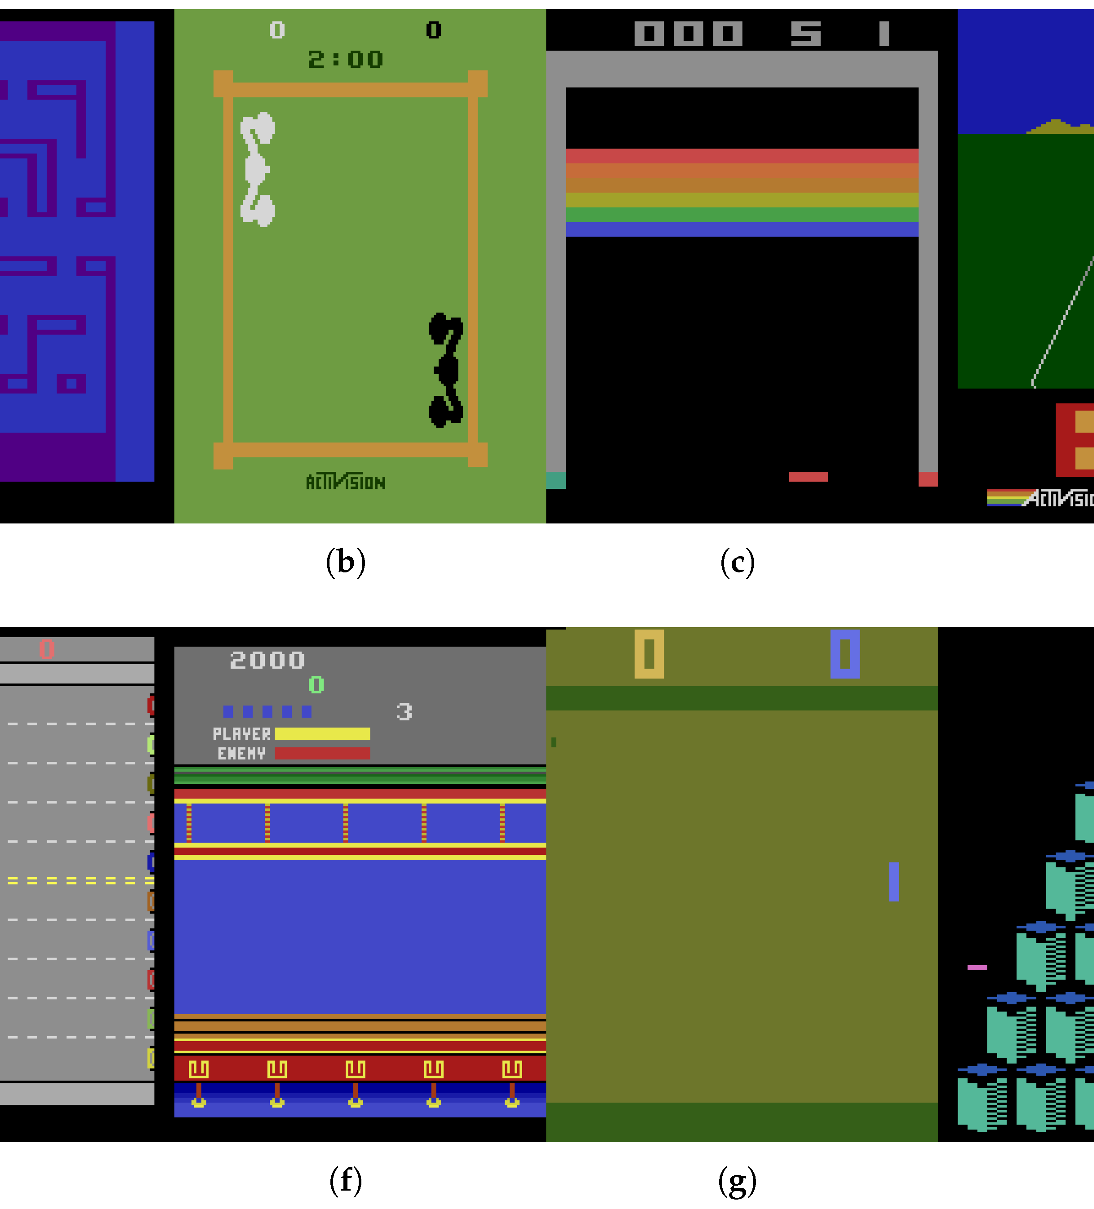
ENVIRONMENT: OBSERVATION SPACE
Convert to grayscale
Resize to 84 x 84
Normalize pixel values to [0, 1]
Stack the last 4 frames to capture motion
Final observation shape: (4, 84, 84)
Why stacking matters: A single frame lacks velocity and direction; stacked frames give temporal context needed for aiming, dodging, and predicting motion

Slide 5
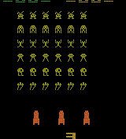
ENVIRONMENT: ACTION SPACE
The environment provides a discrete action set. For Space Invaders, common actions include:
NOOP
FIRE
LEFT
RIGHT
LEFTFIRE
RIGHTFIRE
The agent learns a Q-value for each possible action and selects the highest-valued action (or explores via epsilon-greedy)

Slide 6
ENVIRONMENT: REWARD STRUCTURE
Rewards in Atari are often sparse or delayed. In Space Invaders:
Shooting an enemy grants positive reward
Losing a life or ending the episode is negative but delayed
Some enemy types give different reward values
Challenges
Hard to explore good states early
Delayed rewards make credit assignment difficult
This structure tests the agent's ability to learn long-term planning and consistent targeting behavior

Slide 7
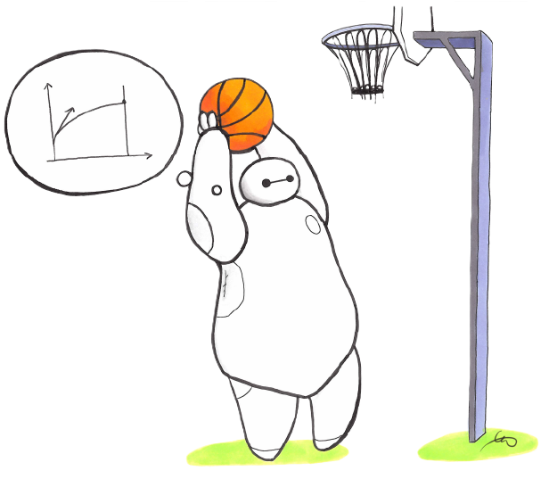

BASELINE DQN ARCHITECTURE
The baseline DQN model consists of:
1. Convolutional Layers to extract spatial features from screen pixels
2. Flatten layer to convert conv outputs into a dense vector
3. Fully Connected Layers to reason about state-action values
4. Output Layer with size equal to number of actions, representing Q-values
The target for DQN is: Q(s, a) r + y * max(Q_target(s', a'))
The max( ) causes DQN to overestimate values, motivating Double DQN.

Slide 8
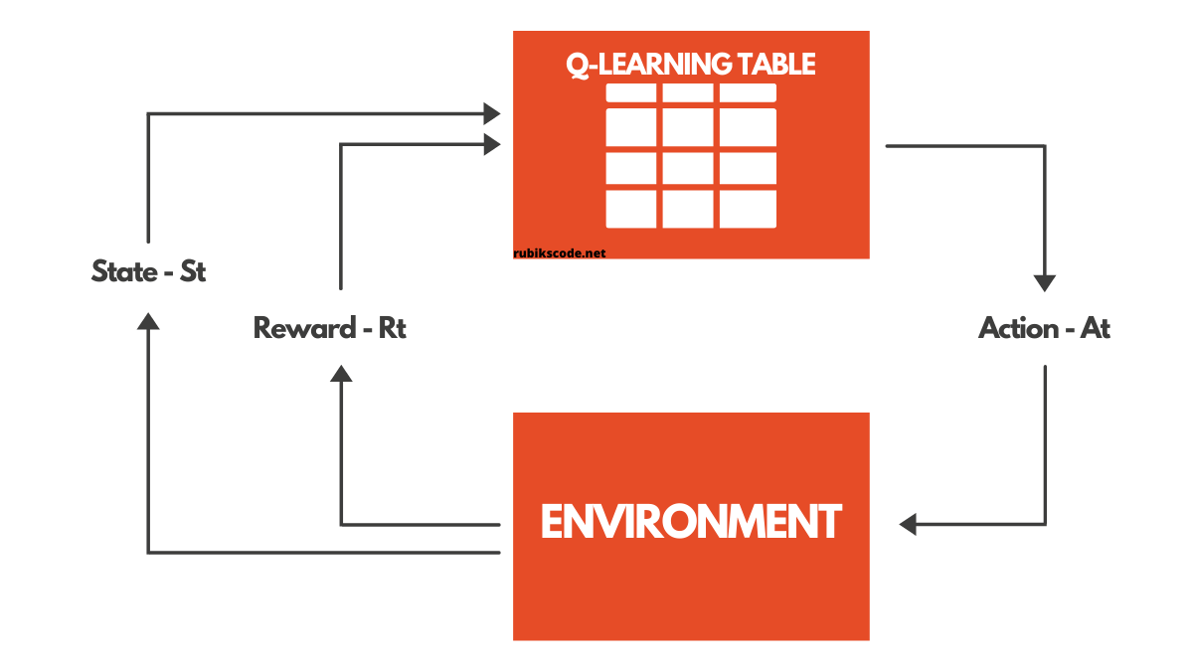
DOUBLE DQN ARCHITECTURE
Double DQN uses the same network structure but changes the target update rule:
1. The online network selects the best action
2. The target network evaluates the value of that action
Target becomes:
Q(s, a) r + y * Q_target(s', argmax_Q_online(s'))
Benefits:
Reduces value overestimation
More stable learning
Smoother reward curve
Double DQN is one of the simplest yet most effective improvements to DQN

Slide 9
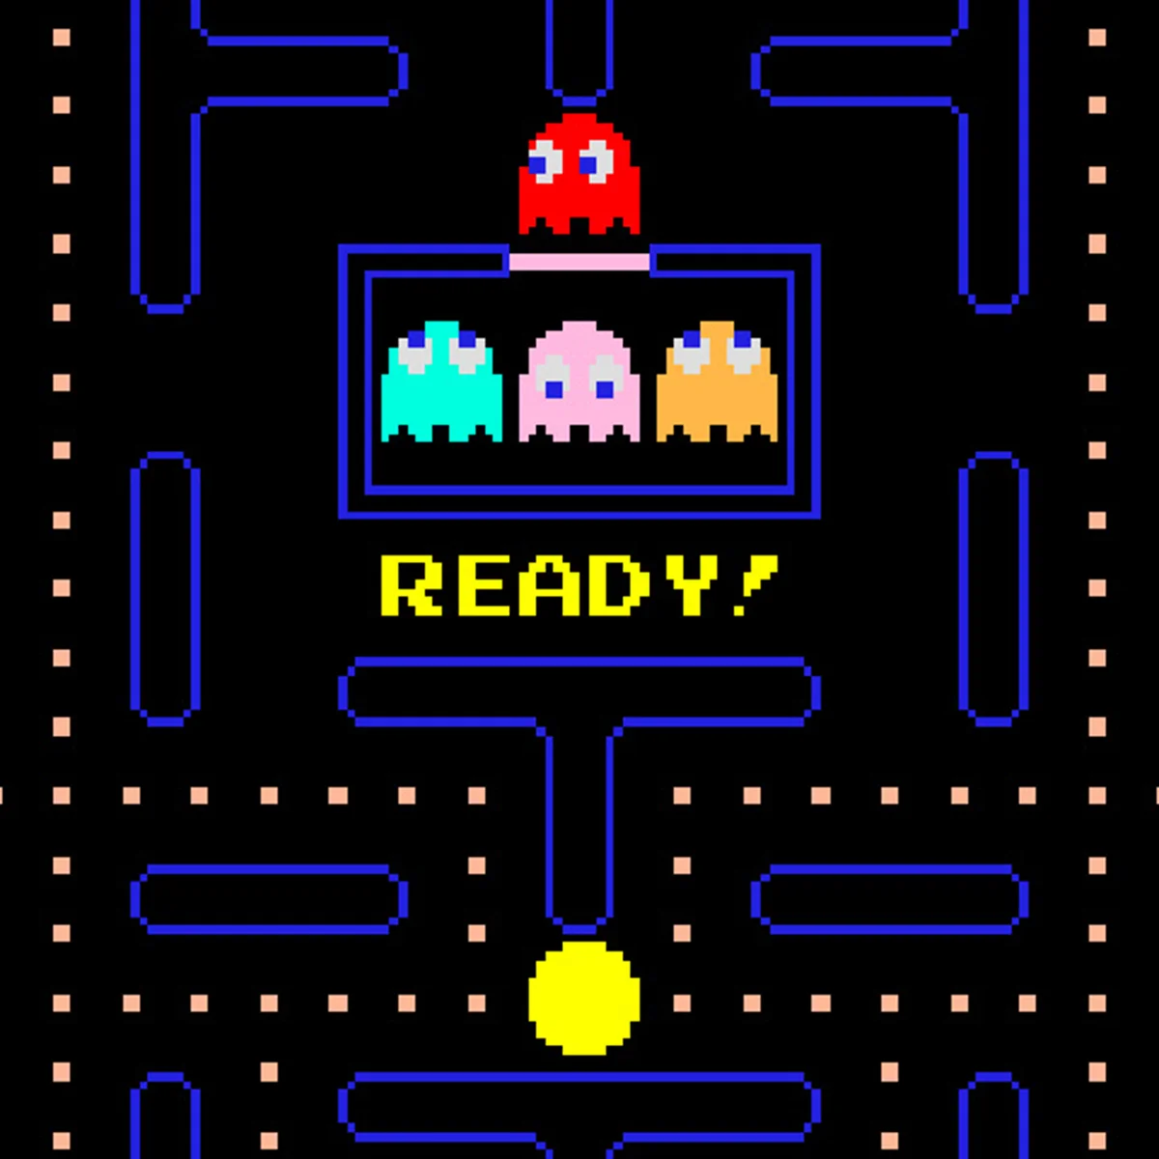
HYPERPARAMETERS (SHARED ACROSS BOTH MODELS)
All runs use the same core hyperparameters (except Double DQN update rule):
Learning Rate: 1e – 4
Optimizer: Adam
Discount Factor y: 0.99
Batch Size: 32
Replay Buffer: 50,000 frames
Target Network Sync: every 5,000 frames
Frame Stack: 4 frames

Slide 10
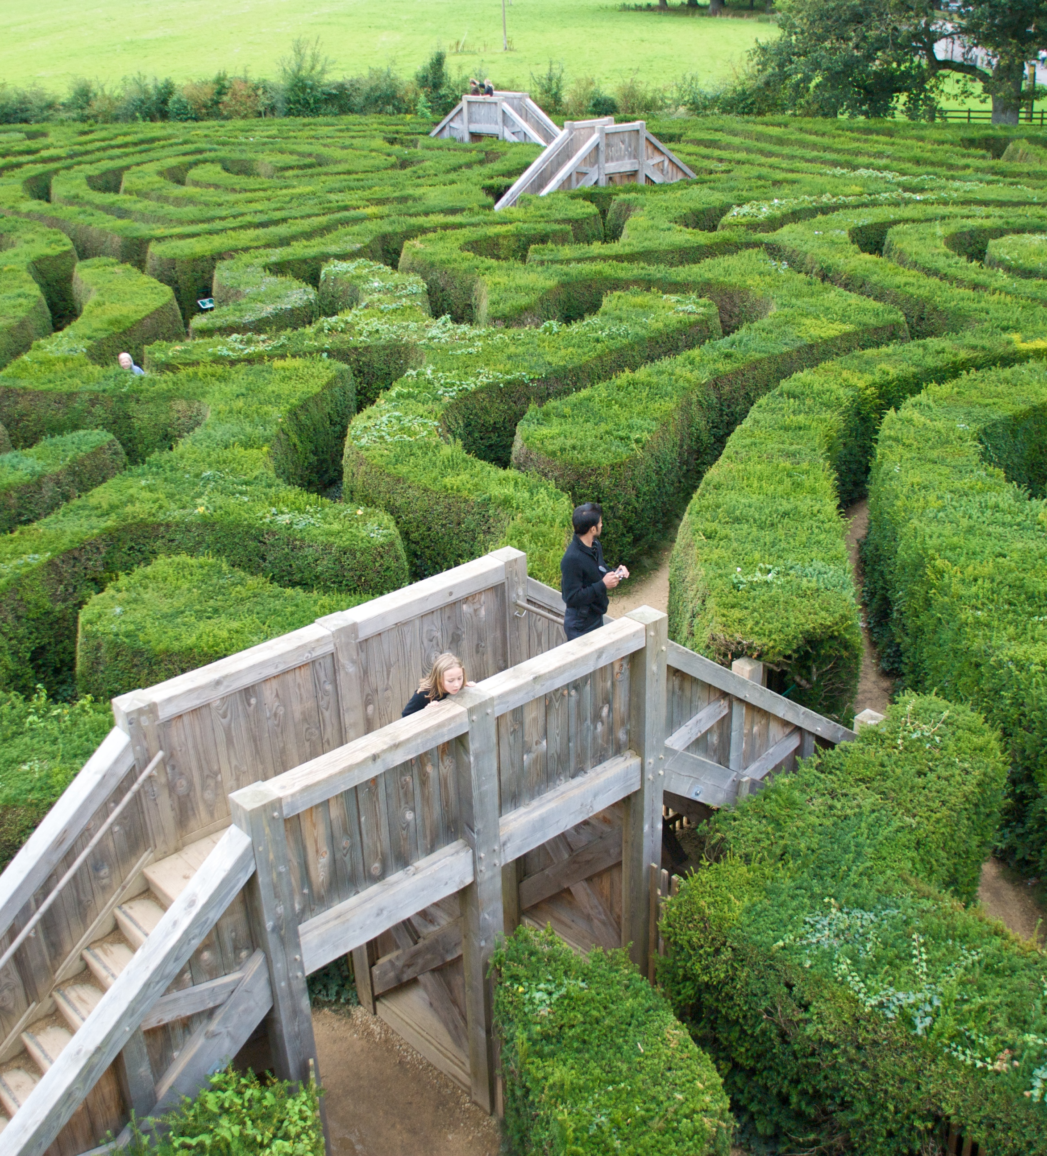
EXPLORATION AND TRAINING DETAILS
Exploration follows epsilon-greedy behavior:
Start: 1.0
Final: 0.05
Decay over: ~300,000 frames
Other settings:
Replay warm-up: 50,000 steps before starting training
Training frames: 1 million (depending on compute)
Gradient updates: 1 per environment step
Video capture: early and late gameplay recorded directly from environment
Longer training improves stability and results in more meaningful comparison between DQN variants.

Slide 11
CODEBASE STRUCTURE
Notebooks/ - DQN + Double DQN training notebooks
Models/ - saved neural network weights
Videos/ - early vs. Learned agent gameplay
Utils/ - replay buffer, preprocessing, wrappers
README.md - experiment notes, video links, learning curves
Report.pdf - 3-5 page summary
Includes adaptation of provided starter code (c166f25_02b_dqn_pong.ipynb).

Slide 12
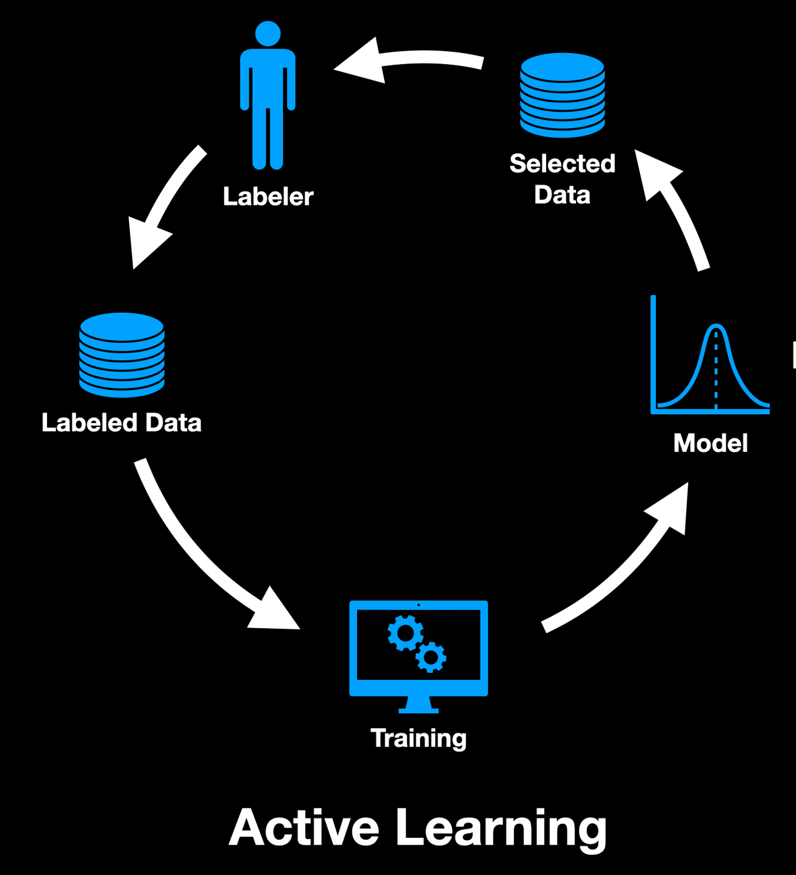
TRAINING LOOP OVERVIEW
Each training iteration follows this cycle:
Agent selects an action using epsilon-greedy policy
Environment executes action and returns next state + reward
Transition stored in replay buffer
If buffer has enough samples:
Sample mini-batch
Compute DQN or Double DQN target
Update online network
Every N steps, sync weights to target network.
Log metrics and episodic rewards
This loop repeats for millions of frames

Slide 13
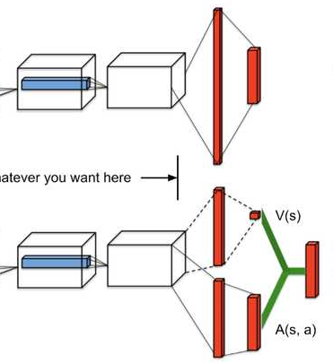
COMPARISON SETUP
To ensure a fair comparison:
Same game environment
Same preprocessing and frame stacking
Same network architecture
Same hyperparameters
Same logging and checkpointing frequency
Only difference: the target computation method (DQN vs. DDQN)
This isolates the effect of Double DQN on stability and performance

Slide 14
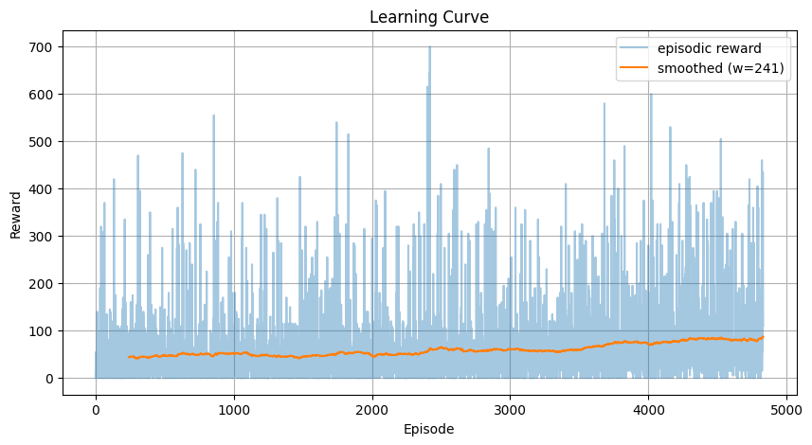
LEARNING CURVE: BASELINE DQN
Key Observations:
Shows improvement over time but with significant variance
Occasional drops due to overestimation leading to poor policies
Sometimes gets stuck in suboptimal behaviors (e.g., firing in place)
Final reward typically lower and less stable than Double DQN

Slide 15
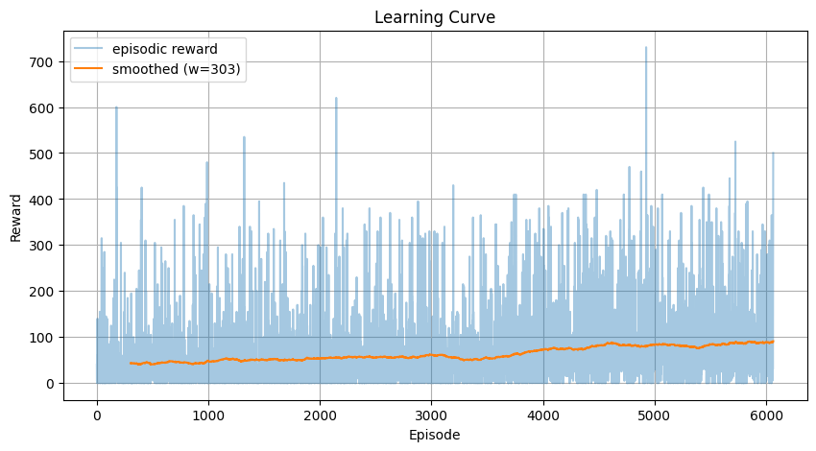
LEARNING CURVE: DOUBLE DQN
Key Observations:
Much smoother learning curve
Reduced spikes nad collapses compared to DQN
Better long-term consistency
Final reward is higher on average
Double DQN avoids overestimated Q-values, resulting in a more robust policy improvement

Slide 16
DQN vs. DOUBLE DQN: COMBINED PLOT
Overlaying both learning curves reveals:
DQN shows earlier improvement but higher variance
Double DQN improves more slowly but more reliably
Double DQN achieves a higher stable plateau with fewer collapses
The difference aligns with published research
Clear visual evidence that Double DQN is more stable and accurate

Slide 17
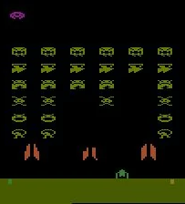
GAMEPLAY VIDEOS: DQN
Early DQN behavior:
Random movement
Frequent unnecessary firing
Poor survival and targeting
Learned DQN behavior:
Better aiming
Sometimes predictable side-to-side pacing
Still prone to over-aggressive errors
GitHub includes 10-30 second MP4 videos

Slide 18
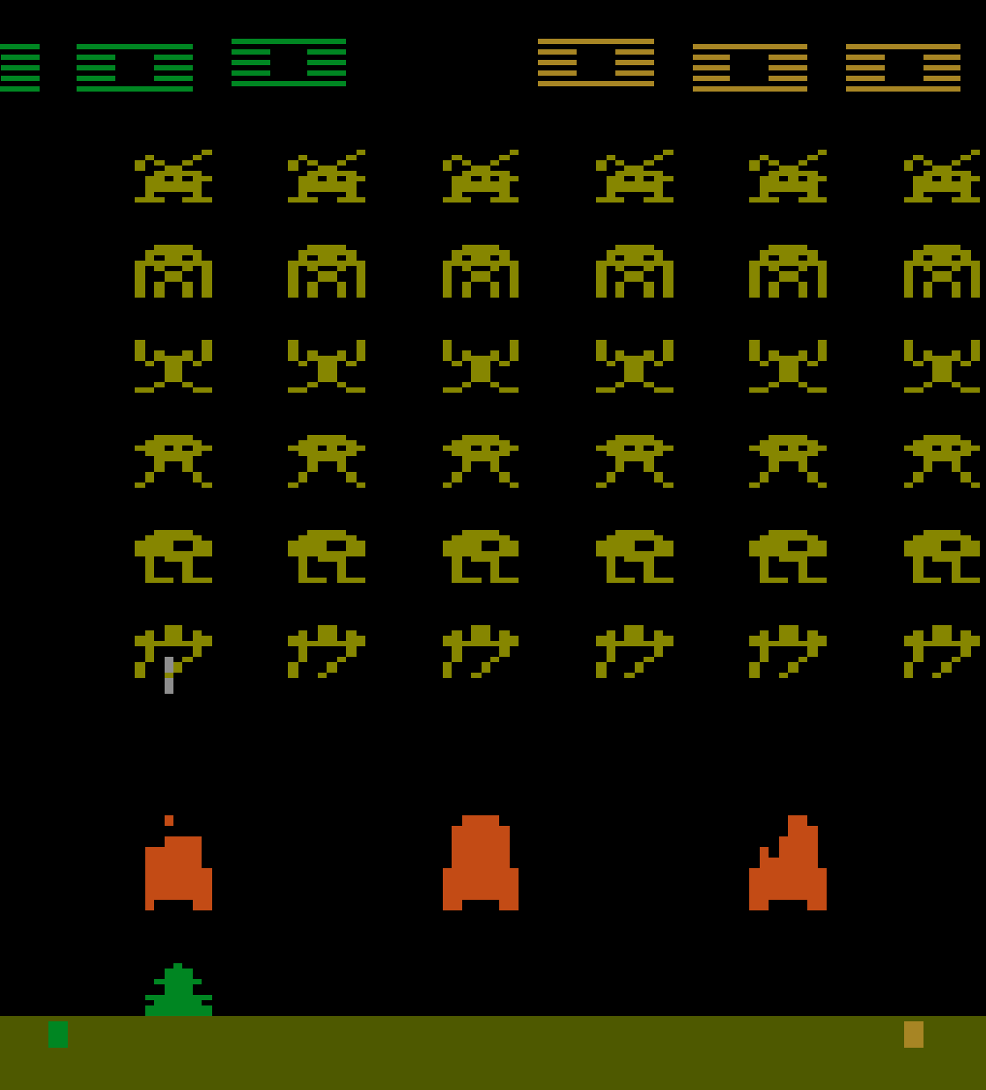
GAMEPLAY VIDEOS: DOUBLE DQN
Early Double DQN behavior:
Similar to random baseline, expectedly chaotic
Learned DQN behavior:
More controlled movement
Better timing for enemy hits
Fewer risky decisions
More consistent score increases
Video clearly shows superior strategy and planning

Slide 19

REFLECTION: CHALLENGES
Challenges faced:
Long training time required to see stable results
Overestimation in DQN making results unstable
Exploration was difficult in early training
Debugging preprocessing, environment wrappers, and rendering
Ensuring frame stacking worked properly
These obstacles reflect common issues in Atari RL research

Slide 20
REFLECTION: WHAT HELPED
Strategies that improved learning:
Switching to Double DQN greatly reduced Q-value overestimation
Increasing replay buffer helped maintain diversity
Slower epsilon decay allowed more early exploration
Careful tuning of target sync frequency improved stability
Reviewing learning curves frequency helped catch issues early
Together, these improvements produced significantly better performance

Slide 21
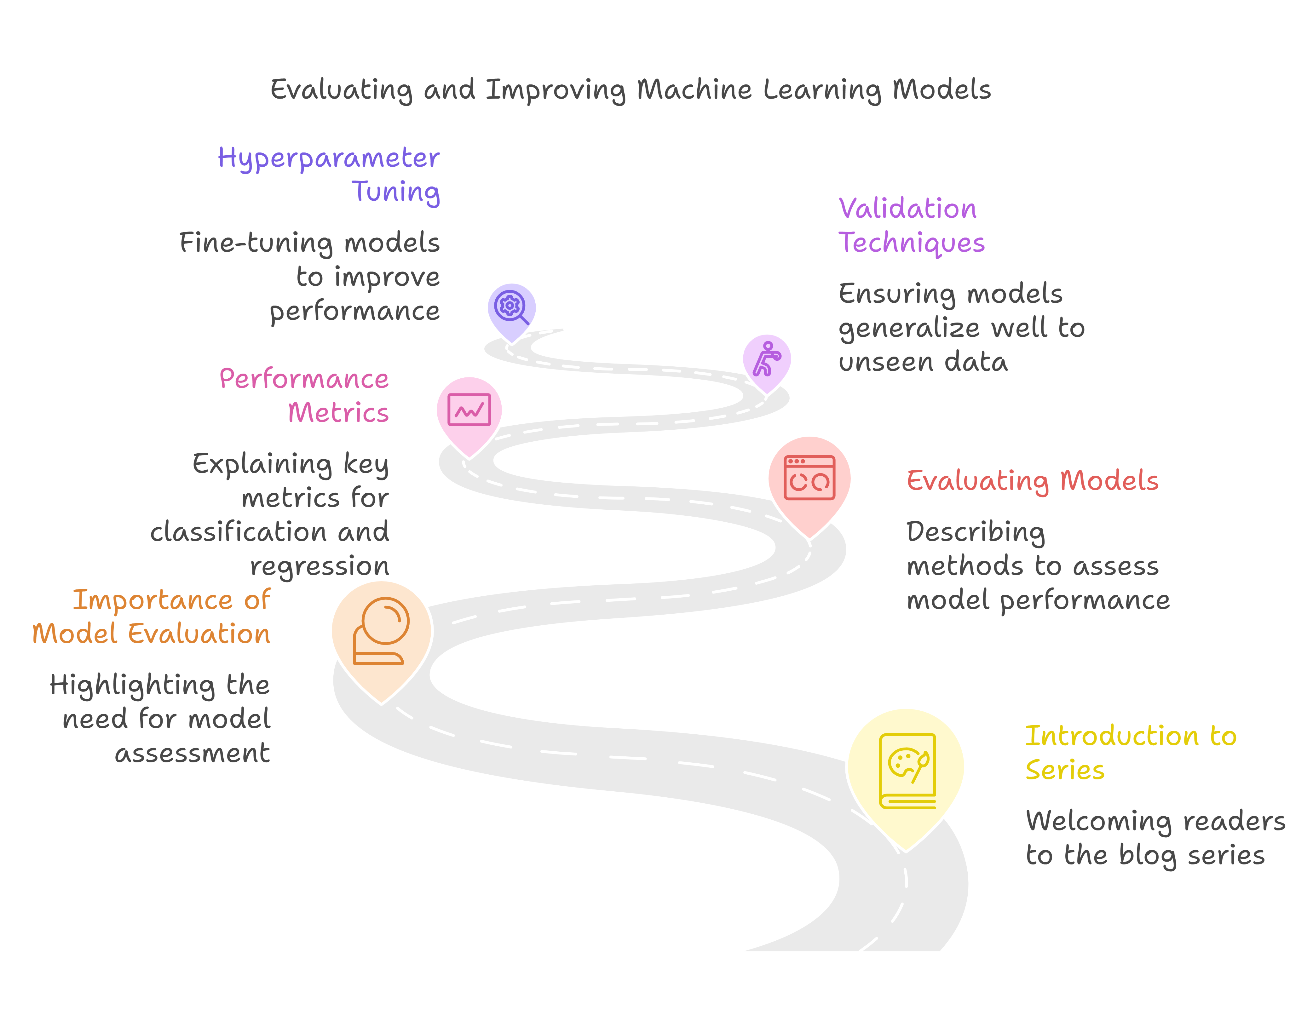
FINAL CONCLUSIONS
Double DQN is clearly superior to standard DQN for Atari tasks requiring stable value estimation
DQN learns but is more erratic and prone to value spikes
Proper exploration scheduling is essential for good performance
Even simple extensions can dramtically improve RL agent stability
The results match expectations from the RL research literature

Slide 22
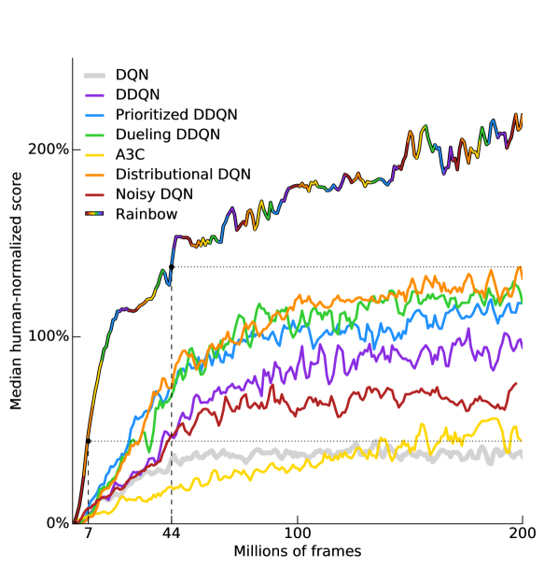
FUTURE WORK
Future possible extensions:
Prioritized Experience Replay (PER)
Dueling DQN architecture
Multi-step returns
Reward shaping or curriculum progression
Trying additional Atari environments
Using Rainbow DQN for advanced performance
These approaches would further improve stability, convergence, and sample efficiency

Slide 23
GITHUB LINK
https://github.com/PaatriickC/CSCI-166-Project.git

